Slide 1
Automated Parking system using license plate detection
- By Puneet Shekhawat and Pankaj

Slide 2
Content:
What is computer vision?
Computer vision Vs Machine learning
Techniques used for license plate detection
Character Recognition
Tools
Advantages
Difficulties

Slide 3
What is computer vision?
Computer vision is a field of computer science that works on enabling computers to see, identify and process images in the same way that human vision does, and then provide appropriate output. It is like imparting human intelligence and instincts to a computer. In reality though, it is a difficult task to enable computers to recognize images of different objects.
Computer vision is closely linked with artificial intelligence, as the computer must interpret what it sees, and then perform appropriate analysis or act accordingly.

Slide 4
Computer vision Vs Machine learning
The main difference is in focus , machine learning is more broad, unified not by any particular task but by similar techniques and approaches. Many machine learning algorithms and systems are pretty agnostic to what the machine is working on--you just need to provide the right set of inputs and features to the algorithm. Very similar classifiers can be used to block spam or identify pictures of cats. Computer vision, on the other hand, is unified by a set of tasks: dealing with images. This requires a fair amount of different technologies--a fair bit of machine learning, to be sure, but also things from AI and signals processing and other fields.

Slide 5
Techniques used for license plate detection:
Thresholding
Morphology
Contours

Slide 6
Thresholding
If pixel value is greater than a threshold value, it is assigned one value (may be white), else it is assigned another value (may be black).
Image thresholding is a simple, yet effective, way of partitioning an image into a foreground and background. This image analysis technique is a type of image segmentation that isolates objects by converting grayscale images into binary images. Image thresholding is most effective in images with high levels of contrast.

Slide 7
Morphology
Morphological image processing is a collection of non-linear operations related to the shape or morphology of features in an image.
Morphological operations rely only on the relative ordering of pixel values, not on their numerical values, and therefore are especially suited to the processing of binary images. Morphological operations can also be applied to greyscale images such that their light transfer functions are unknown and therefore their absolute pixel values are of no or minor interest.

Slide 8
Contours
Contours can be explained simply as a curve joining all the continuous points (along the boundary), having same color or intensity. The contours are a useful tool for shape analysis and object detection and recognition.

Slide 9
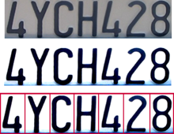
Character Recognition:
Character Recognition is performed using knn
Knn:
In patter recognition, the k-nearest neighbors algorithm (k-NN) is a non-parametric method used for classification and regression. In both cases, the input consists of the k closest training examples in the feature space. The output depends on whether k-NN is used for classification or regression.

Slide 10
Tools used:
For algorithm:
Jupyter notebook
Spyder
Open CV
KNN
For embedding in web:
Flask
MySQL

Slide 11
Advantages:
Automating process will help in avoid human error .
Easy , hassle free execution of process.
Time saving.
Can be used to detect and locate stolen cars using police database for such cars.

Slide 12
Difficulties:
Poor file resolution
Blurry images
Poor lighting

Slide 13
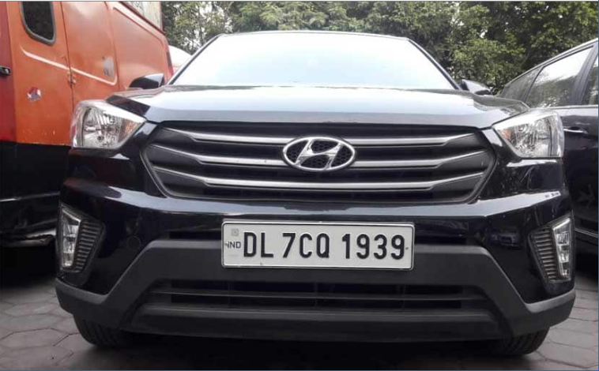
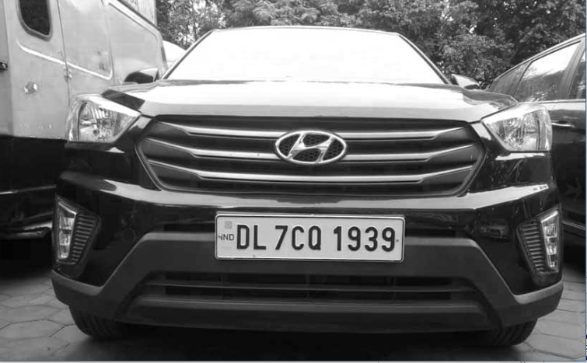
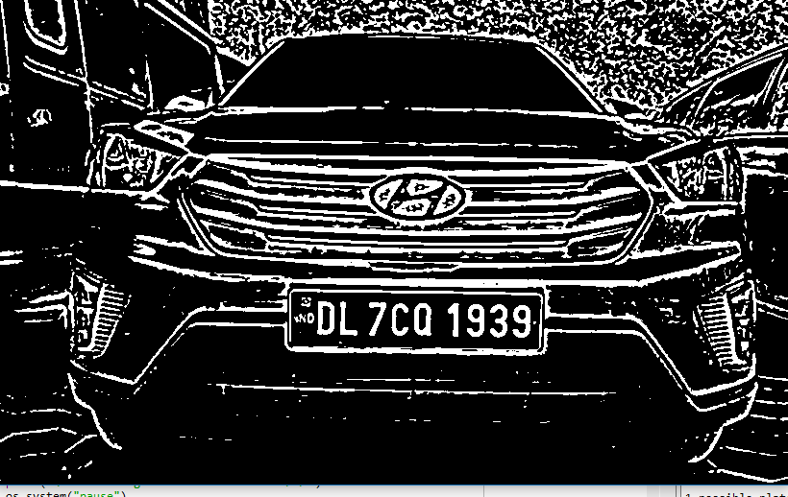
Functions Effect on Image

Slide 14
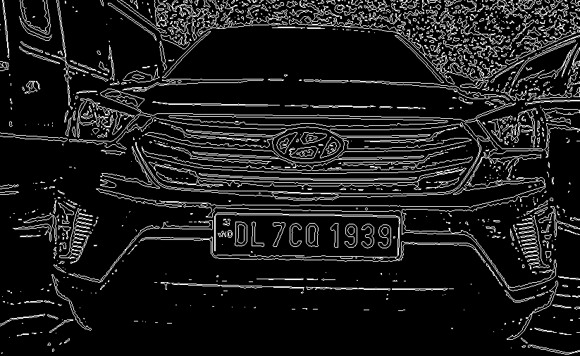

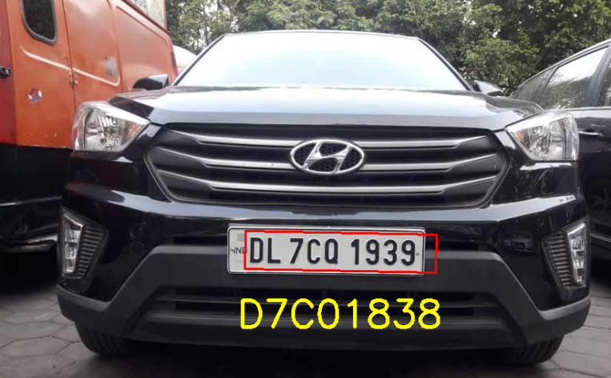


Slide 15
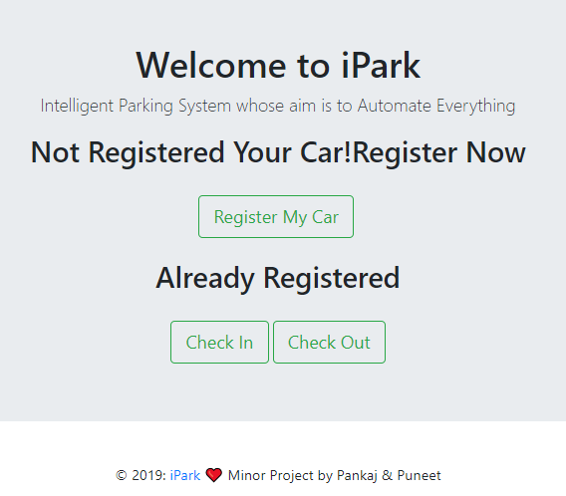
How its Done in Web
First We Register our Car
By Clicking On “Register My Car”

Slide 16


Register And then Login
Register By entering Name ,Email, Car Number and password
Then Login Using Email and Password

Slide 17


Dashboard
1)Get information about previous parking.
2) Charges due.
3)Make payment.

Slide 18


Check In & Check Out (ML)
Checking in and checking out of vehicle at entry/exit gates
of parking lot By using liscence plate detection Module

Slide 19
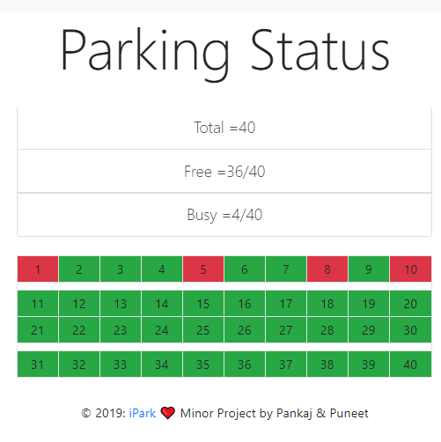
Parking Status
Live Parking status which tells about which slot is filled and which slot is free and total slots.

Slide 20
References:
1) Sendex youtube channel : https://www.youtube.com/playlist?list=PLQVvvaa0QuDdttJXlLtAJxJetJcqmqlQq
2) Coursera(Machine learning): https://www.coursera.org/lecture/machine-learning
Stack overflow
Coursera(Computer vision): https://www.coursera.org/learn/neural-networks-deep-learning/home/welcome

Slide 21
Thank You

